Slide 1
Access 2016 Module 5
Modifying the Database Structure

Slide 2
Module Objectives
Examine relational databases
Design related tables
Create one-to-many relationships
Create Lookup fields
Modify Short Text fields
Modify Number and Currency fields
Modify Date/Time fields
Modify validation properties
Create Attachment fields

Slide 3
Examine Relational Databases (Slide 1 of 3)
The purpose of a relational database is to organize and store data in a way that minimizes redundancy and maximizes your flexibility when querying and analyzing data
To redesign a list into a relational database
Design each table to contain fields that describe only one subject
Identify a primary key field for each table
Build one-to-many relationships

Slide 4
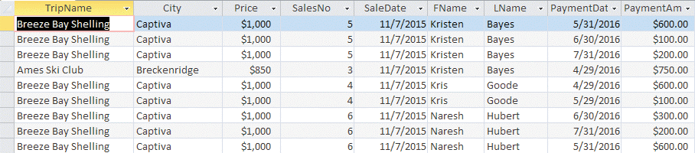
Examine Relational Databases (Slide 2 of 3)
Single Sales table results in duplicate data

Slide 5
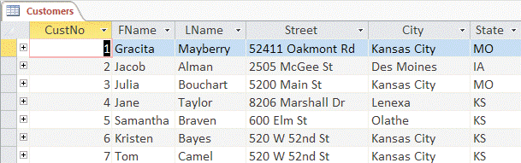
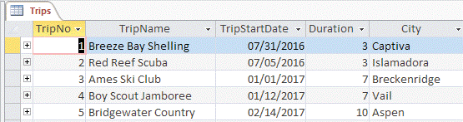
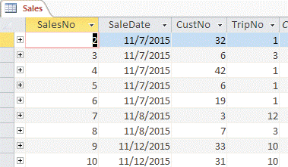
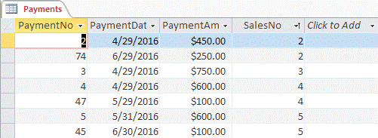
Examine Relational Databases (Slide 3 of 3)
Related tables reduce redundant data

Slide 6
Design Related Tables (Slide 1 of 2)
Develop a valid relational database design, then define the tables
Using Table Design View, can specify all characteristics of a table including:
field names
data types
field descriptions
field properties
Lookup properties
primary key field designations

Slide 7
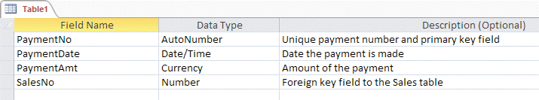
Design Related Tables (Slide 2 of 2)
Table Design View for the new Payments table

Slide 8
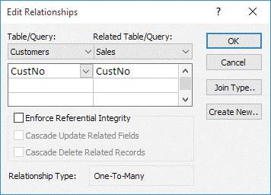
Create One-to-Many Relationships (Slide 1 of 2)
Create tables then link them together in appropriate one-to-many relationships
Use primary key field in “one” table
Use foreign key field in “many” table
Establish relationships before building queries, forms or reports for multiple tables

Slide 9
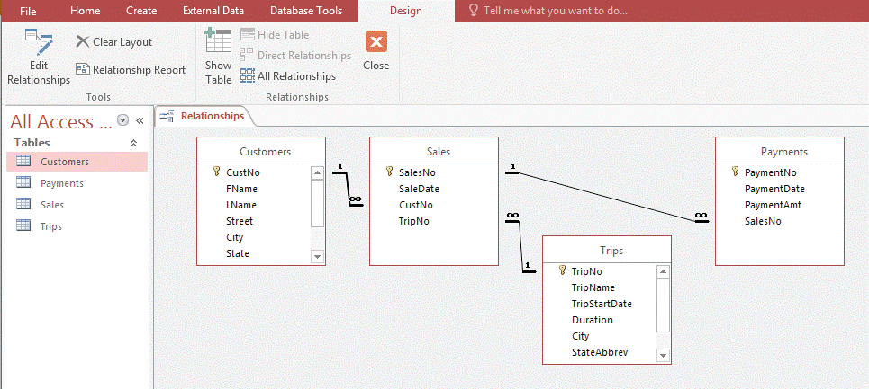
Create One-to-Many Relationships (Slide 2 of 2)
Final Relationships window

Slide 10
Create Lookup Fields (Slide 1 of 2)
Lookup field
a field that contains Lookup properties
Lookup properties
field properties that supply a drop-down list of values for a field
values can be stored in another table or directly stored in Row Source Lookup property of field.
Can set Lookup properties for a field in Table Design View using Lookup Wizard

Slide 11
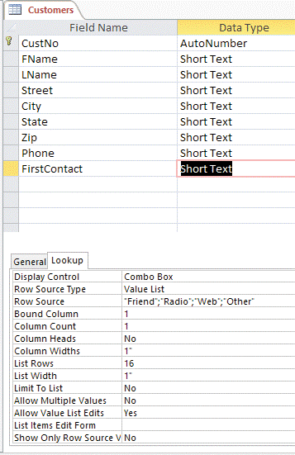
Create Lookup Fields (Slide 2 of 2)
Viewing Lookup properties

Slide 12
Modify Short Text Fields (Slide 1 of 3)
Field properties are the characteristics that describe each field
Field Size
Default Value
Caption
Row Source
Properties help ensure database accuracy and clarity

Slide 13
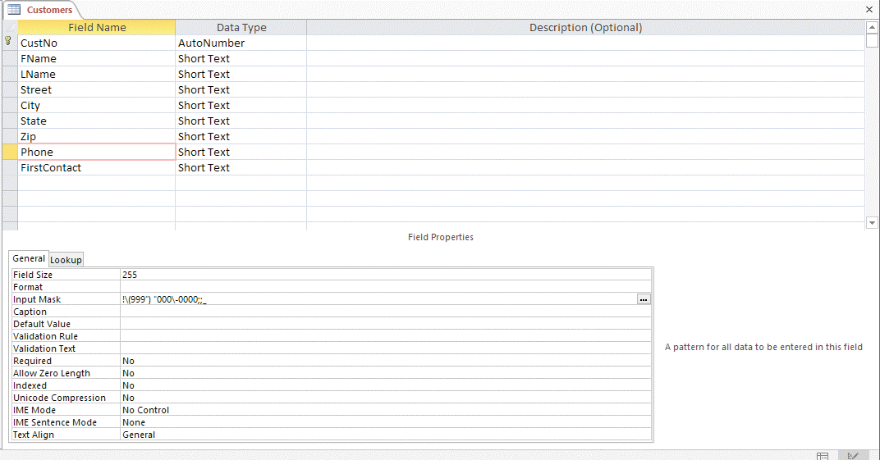
Modify Short Text Fields (Slide 2 of 3)
Changing Short Text field properties

Slide 14
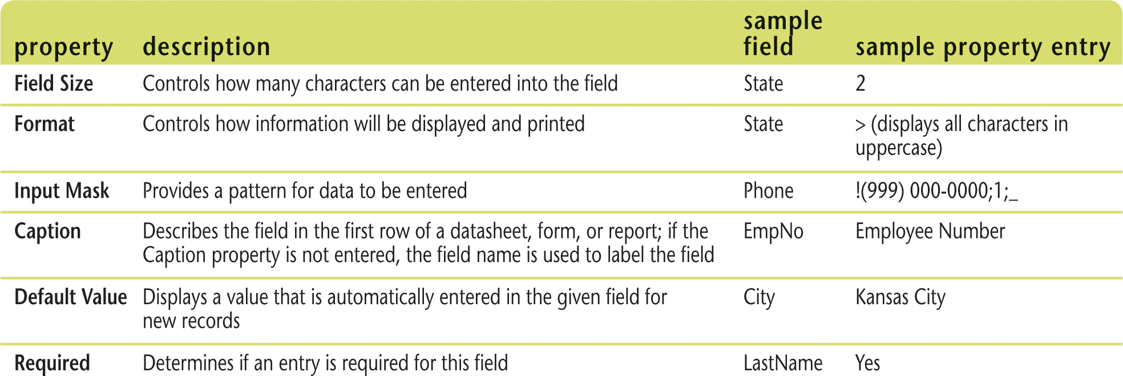
Modify Short Text Fields (Slide 3 of 3)
Common Short Text field properties

Slide 15
Modify Number and Currency Fields (Slide 1 of 3)
Number and Currency fields
have similar properties because they both contain numeric values
Currency fields store values that represent money
Number fields store values that represent values such as quantities, measurements, and scores

Slide 16
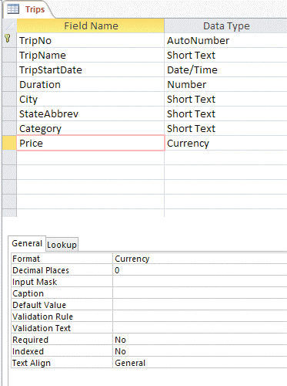
Modify Number and Currency Fields (Slide 2 of 3)
Changing Currency and Number field properties

Slide 17
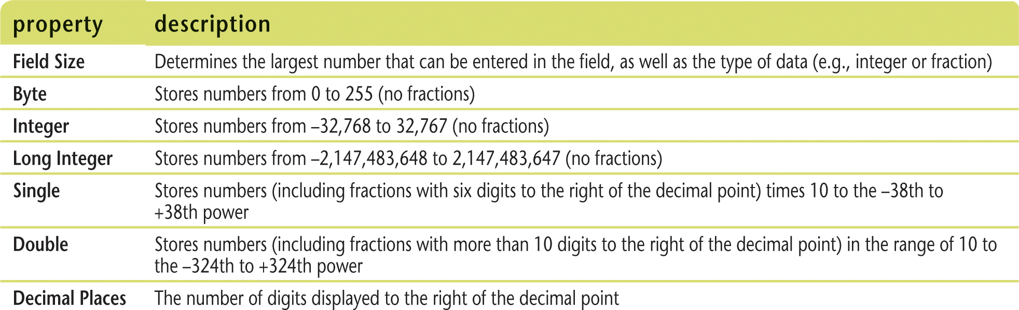
Modify Number and Currency Fields (Slide 3 of 3)
Common Number field properties

Slide 18
Modify Date/Time Fields (Slide 1 of 2)
Date/Time field properties are same as Short Text or Number data types
One difference
Format property, which helps you format dates in various ways such as January 25, 2017; 25-Jan-17; or 01/25/2017

Slide 19
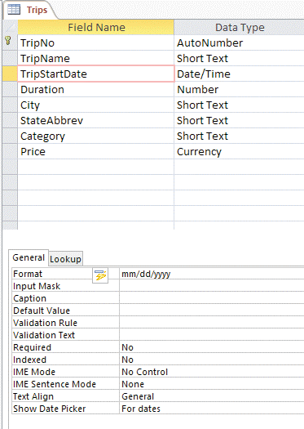
Modify Date/Time Fields (Slide 2 of 2)
Changing Date/Time field properties

Slide 20
Modify Validation Properties (Slide 1 of 3)
Validation Rule property
determines what entries a field can accept.
Validation Text property
displays an explanatory message when a user tries to enter data that breaks validation rule

Slide 21
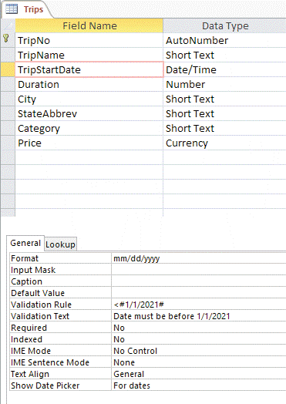
Modify Validation Properties (Slide 2 of 3)
Entering Validation properties

Slide 22
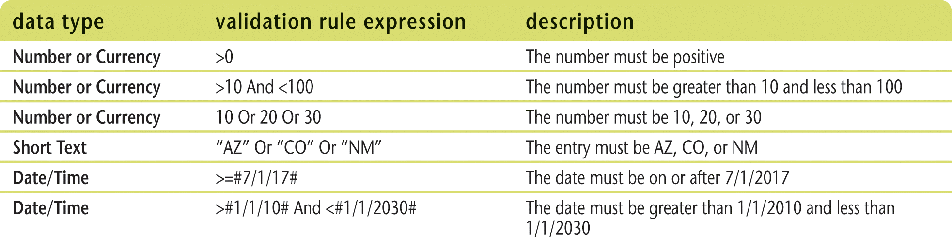
Modify Validation Properties (Slide 3 of 3)
Validation Rule expressions

Slide 23
Create Attachment Fields (Slide 1 of 2)
Attachment field
allows you to attach an external file to a record
Attachment data type is superior to OLE
it stores data more efficiently, stores more file formats, and requires no additional software to view the files from within Access

Slide 24
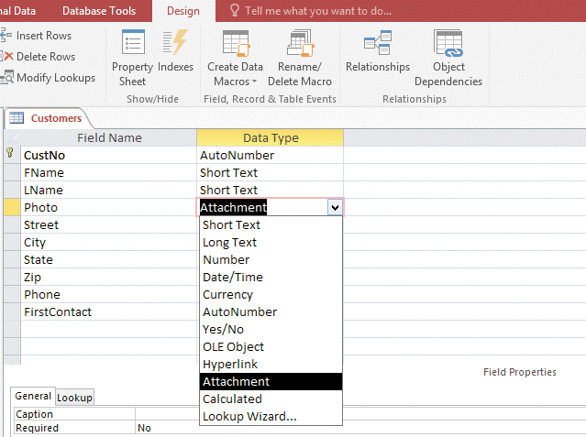
Create Attachment Fields (Slide 2 of 2)
Adding an Attachment field

